Slide 1
Recovery
Recovery plans, habitat management and removal of toxic substances.

Slide 2
Excerpt from: Recovery Plan for the Nightingale Reed-warbler
Provisions to protect reed-warbler habitat and to mitigate for loss of habitat have generally been included by the CNMI-DFW in permits for such projects. In addition, efforts are currently underway on Saipan to develop Habitat Conservation Plans (HCP) that include the establishment of an upland mitigation bank to maintain and enhance habitat for Nightingale Reed-warblers and other native endemic species. The CNMI government has also expressed an interest in developing a regional HCP for Saipan and the northern Mariana Islands.

Slide 3
Objectives
Review the components of an endangered species recovery plan.
Consider techniques for restoration of habitats, including removal of invasive species.
Investigate the role of toxins to populations and how they may be removed from the environment.

Slide 4
Endangered Species Recovery Plans
The Endangered Species Act requires that a plan be developed for the species’ recovery.
The plan generally consists of the following parts:
Species background- a compilation of existing knowledge about habitat use, population size and trends, reproduction, distribution and other relevant knowledge about the species’ natural history.
Evaluation of evidence for threats facing the species, including human impacts, habitat issues and effects of introduced species.
Development of a plan to deal with the agents of decline, including pest control, habitat protection, habitat restoration, controlling overharvest and consideration of captive breeding.
Assessment, based on recruitment and survivorship data when available, of minimum viable population size and distribution upon recovery.
Nightingale Reed-warbler being released after measuring and banding.
Development of a timetable for recovery.
Estimate of annual recovery budget.

Slide 5
Habitat Restoration
Part of recovery efforts can be to recreate or repair habitats damaged through development, filling, conversion to agriculture or being overwhelmed by alien species.
Wetlands and former open pit mines in particular have been the subject of restoration efforts.
In the case of wetlands, regrading filled wetlands to elevations conducive to reestablishment of wetland vegetation is practiced.
Where tidal access has been blocked, tidal barriers such as fill or tide gates can be removed.
In Connecticut, removal of tide gates has also proven effective at eliminating Phragmites cover and replacing it with native salt marsh vegetation due to increasing water salinity past 18 ppt- toxic to Phragmites- with the return of tidal water.
Where removing fill is impractical, such as at the landfill at right, capping with soil and revegetating it has still returned the area to one useable by wildlife.
Former tidal wetland in Old Saybrook, CT once used as a landfill.
Doing so also provides an undeveloped buffer adjacent to a remaining tidal wetland that is inhabited by several rare species.

Slide 6
Regenerating Native Forest
Case study: tropical island forest
Tropical island forests that have developed over millennia create their own humid microclimates, rapidly recycle nutrients through a system with a nominal soil layer, and provide a cool, dark, moist microenvironment for seed germination.
When this forest is cut, nutrients are rapidly lost and the environment becomes hotter and drier, making natural regeneration of forest difficult.
As demonstrated by field study, reforestation does occur slowly, with pioneer native seedlings of certain species invading the understory of alien thickets, thereby modifying the environment so that other natives may follow.
To assist with speeding reforestation, sapling natives grown in cultivation are planted, fertilized and watered to ensure their survival.
In addition, periodic management has been required to cut back alien vines, thereby keeping the vines from overwhelming the native seedlings.
Old growth Micronesian forest has humidity high enough to support dense epiphytic growth.

Slide 7
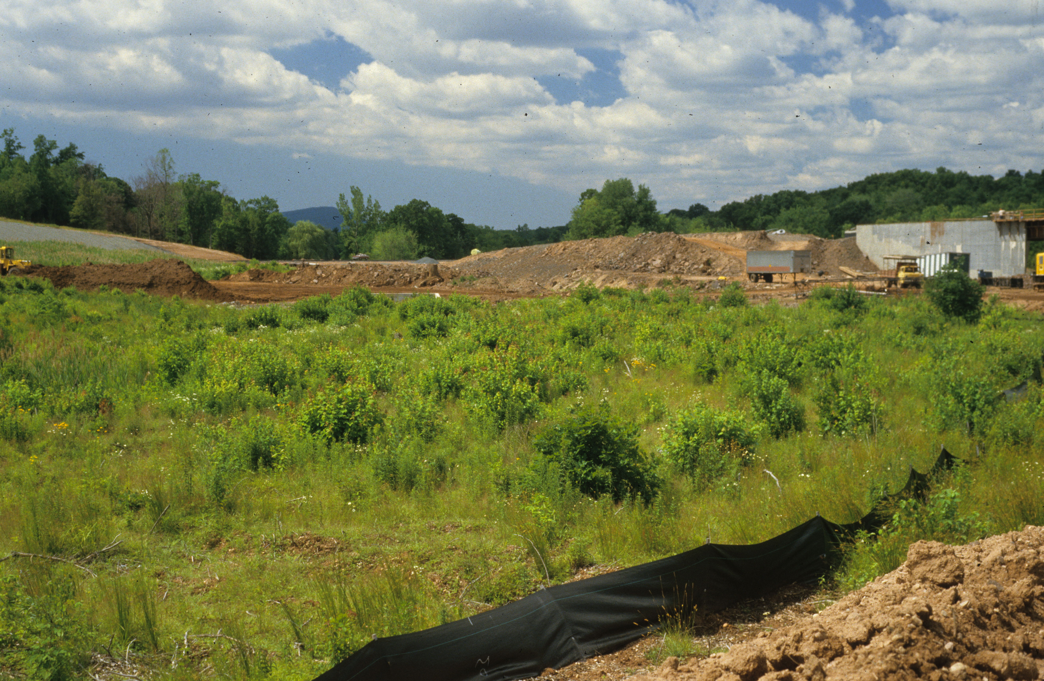
Mitigation
When habitats are destroyed during development, the damage may be mitigated through creation of new habitats to replace them.
This has been done particularly for wetlands disturbed through development.
The photograph at left shows a basin being excavated to replace a wetland destroyed through highway development.
The image above shows the same area after emergent marsh vegetation has begun to colonize.

Slide 8
Control of Invasives
Invasive plants are a major source of habitat disruption that can lead to species endangerment.
Multiple approaches to invasive removal have been developed, including chemical, mechanical and biological methods.
Chemical eradication is generally carried out by using a broad spectrum herbicide like glyphosate. More targeted chemical control can be accomplished by using an agent like 2,4-D, which selectively removes dicots.
Biological methods include introduction of a disease or predator on the invasive.
Case study: Purple Loosestrife
The loosestrife Lythrum salicaria is an invasive weed of freshwater marshes, where it alters vegetation structure and excludes native plants from communities.
Some native birds use the woody overwintering stems as nesting substrates but other species avoid it.
Much of the Cromwell Meadows in CT- one of the largest freshwater marshes in the state- have been overwhelmed by Lythrum.

Slide 9
Invasive Control- continued
They are also used to control a variety of aquatic weeds, most notably Eichhornia (Water Hyacinth).
Small populations may be controlled by mechanical removal or herbicides.
Herbicides have too many negative effects on systems to use on large populations, however, so biological control is used.
Several pests, including leaf-feeding Galerucella as well as several species of weevils have proven effective at controlling populations of Lythrum.
Case study: Florida Everglades
Biological control is also a major component in this system, which has been degraded through the introduction of alien trees and aquatic plants.
Insects are used to control Melaleuca and Schinus trees that replace natives in upland patches (hardwood hammocks).
The borders of Fisheating Creek at the north end of the
Everglades are choked with alien aquatic weeds.

Slide 10
Invasive Animals
Not only plants and insects can be invasive. Ungulates like goats and pigs are significant conservation problems on islands.
Case study: Sarigan, Mariana Islands
Populations of feral goats were established on this and other islands by Spanish explorers in the 1500s, although prehistoric Micronesians brought pigs.
Their feeding has altered ecosystems by disrupting forest regeneration and differentially removing plant species from the forest community.
Fossil evidence shows that additional bird species once occupied islands in this chain, and actions of feral ungulates are likely a factor in these disappearances.
More recently, 1990 surveys on Sarigan found only five White-throated Ground Doves, whereas on islands with no ungulates they are common. By 1997, three bird were found.
Eradication of goats and pigs is being attempted via hunting.
White feral goats on the tropical island of Sarigan may be seen at the base of the valley.

Slide 11
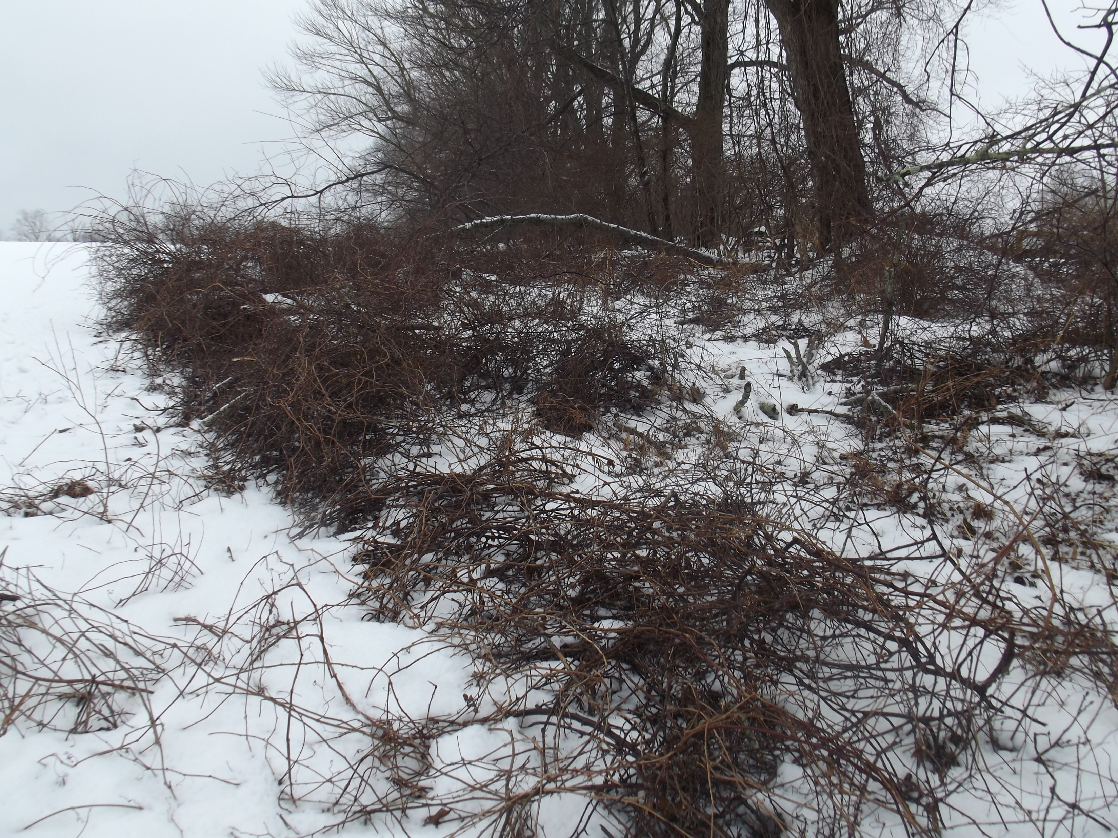
Mechanical Control
Mechanical methods are sometimes used to control species like Phragmites, where plants and roots are physically removed by machinery, although herbicides prove most effective at control.
Mechanical removal of invasive woody vegetation is more effective when it can be followed by periodic mowing.
This strategy is used to restore hayfields occupied by grassland species, as woody aliens are eliminated by regular mowing.
Winter is the optimal time for clearing alien thickets. These images show a Rosa multiflora thicket before and after clearing and being prepared for spring mowing.

Slide 12
Fire Management
Wildfire is integral to the ecology of certain ecosystems, including native grasslands, western conifer parklands and chaparral.
Species in these systems have evolved adaptations to fire such that they are most successful in its presence.
Adaptations include the development of thick bark and serotinous cones- those that open in response to the heat of fires to broadcast seeds.
Exclusion of fire from them can result in succession to deciduous woody vegetation or, as fuelwood accumulates, much hotter fires that destroy the ecosystem.
However, with regular wildfires, less fuel accumulates, fires burn with lower intensity and the systems rapidly recover.
The chaparral of southern California is a system adapted to periodic wildfire.
In the absence of naturally-occurring wildfires, managers may set them. These prescribed burns generally require the establishment of a firebreak to control the extent of the burn.

Slide 13
Endangered Habitats
An East Coast habitat with some ecological similarities to chaparral is the sand plain.
They may be thought of as the descendants of scrub communities that were widespread in the East earlier in Pleistocene times.
They are savannah-like in their openness and are maintained by periodic wildfire. Without fire, they succeed to deciduous forest.
Fire is necessary to open the cones of a keystone species, the Pitch Pine, and to prepare mineral soil to receive the seeds.
Although more widespread on the coastal plain, they are rare in New England, where they tend to develop on sandy glacial outwash and recessional moraines.
Sand plains provide habitat for a number of endemic New England plant species.
This sand plain developed on the shores of the ancient glacial lake that is now Cape Cod Bay.
Due to urbanization and fire suppression, these habitats and their distinctive communities are endangered with disappearance.
In many states, such habitats are afforded protection similar to that of endangered species.

Slide 14
Environmental Toxins
Toxic chemicals and heavy metals pose significant threats to all species and are a cause of decline particularly among species at the highest trophic levels. Examples follow:
Polychlorinated biphenyls (PCBs) are highly stable liquids were manufactured as a coolant, insulating fluid and fire retardant, with waste contaminating soil and watercourses.
Long term exposure to sublethal concentrations PBCs is associated with endocrine disfunction, reduced fecundity, birth defects and cancers, although fish species appear to show few toxic effects.
Dioxins are chemically related compounds produced as biproducts from other chemical reactions, particularly the combustion of chlorine-containing compounds.
Some forms are potent carcinogens and are also associated with conditions similar to those produced by PCBs.
Mercury- sublethal doses from sources like burning coal bioaccumulates in tissues and is difficult to purge from them.
It reduces fecundity and has a range of hormonal, neurological and developmental effects.
The sediments of Housatonic River in CT and MA are contaminated with PCBs.

Slide 15
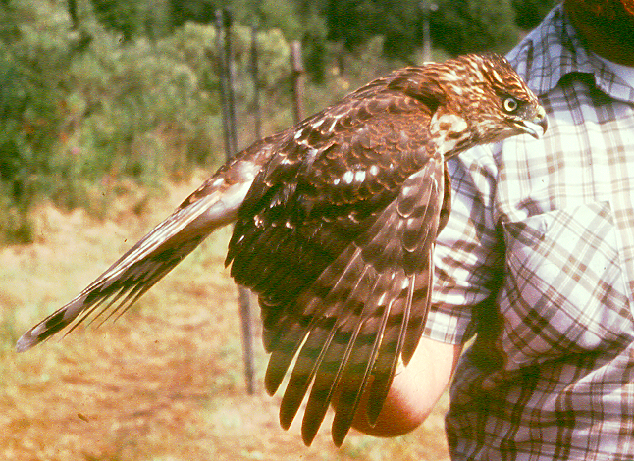
Biomagnification
Because each succeeding trophic level typically is composed of fewer individuals, all toxins encountered in lower trophic level are concentrated into fewer individuals.
Most biomagnification effects are noted in secondary and tertiary consumers (top carnivores).
Animals like the bird-eating Cooper’s Hawk and Peregrine Falcon as well as the fish-eating Bald Eagle suffered severe declines beginning in the 1950s as a consequence of biomagnification of pesticides that persist for decades in the environment.
These chemicals, notably chlorinated hydrocarbons, can accumulate in nervous tissue causing acute poisoning. At lower concentrations, they produced chronic effects, including interfering with calcium metabolism and, hence, the production of egg shells.
Case study: Osprey
A fall migrant female Cooper’s Hawk.

Slide 16
Osprey Recovery
Into the 1940s, eastern Long Island Sound had among the highest population densities of Ospreys in the world.
By the 1950s it was clear that a decline was occurring and by 1969 under 150 nests remained in Connecticut.
Initial thinking was that nest predation, human disturbance and habitat loss were responsible, so nest platforms were constructed.
By 1974 nine nests remained, with only one pair left on the Connecticut River.
By this time, the role of DDT in producing low hatching success through thin eggshell syndrome was clear.
To prevent local extinction, an effort was initiated to move eggs from healthy populations in Chesapeake Bay to the nests of Connecticut Ospreys, with the expectation that locally-reared chicks would have site fidelity and return to Connecticut.
This effort proved successful, and the descendants of these birds numbered 294 pairs in 2017.
However, recovery occurred only when sufficient time had passed to reduce DDT concentrations in the environment.

Slide 17
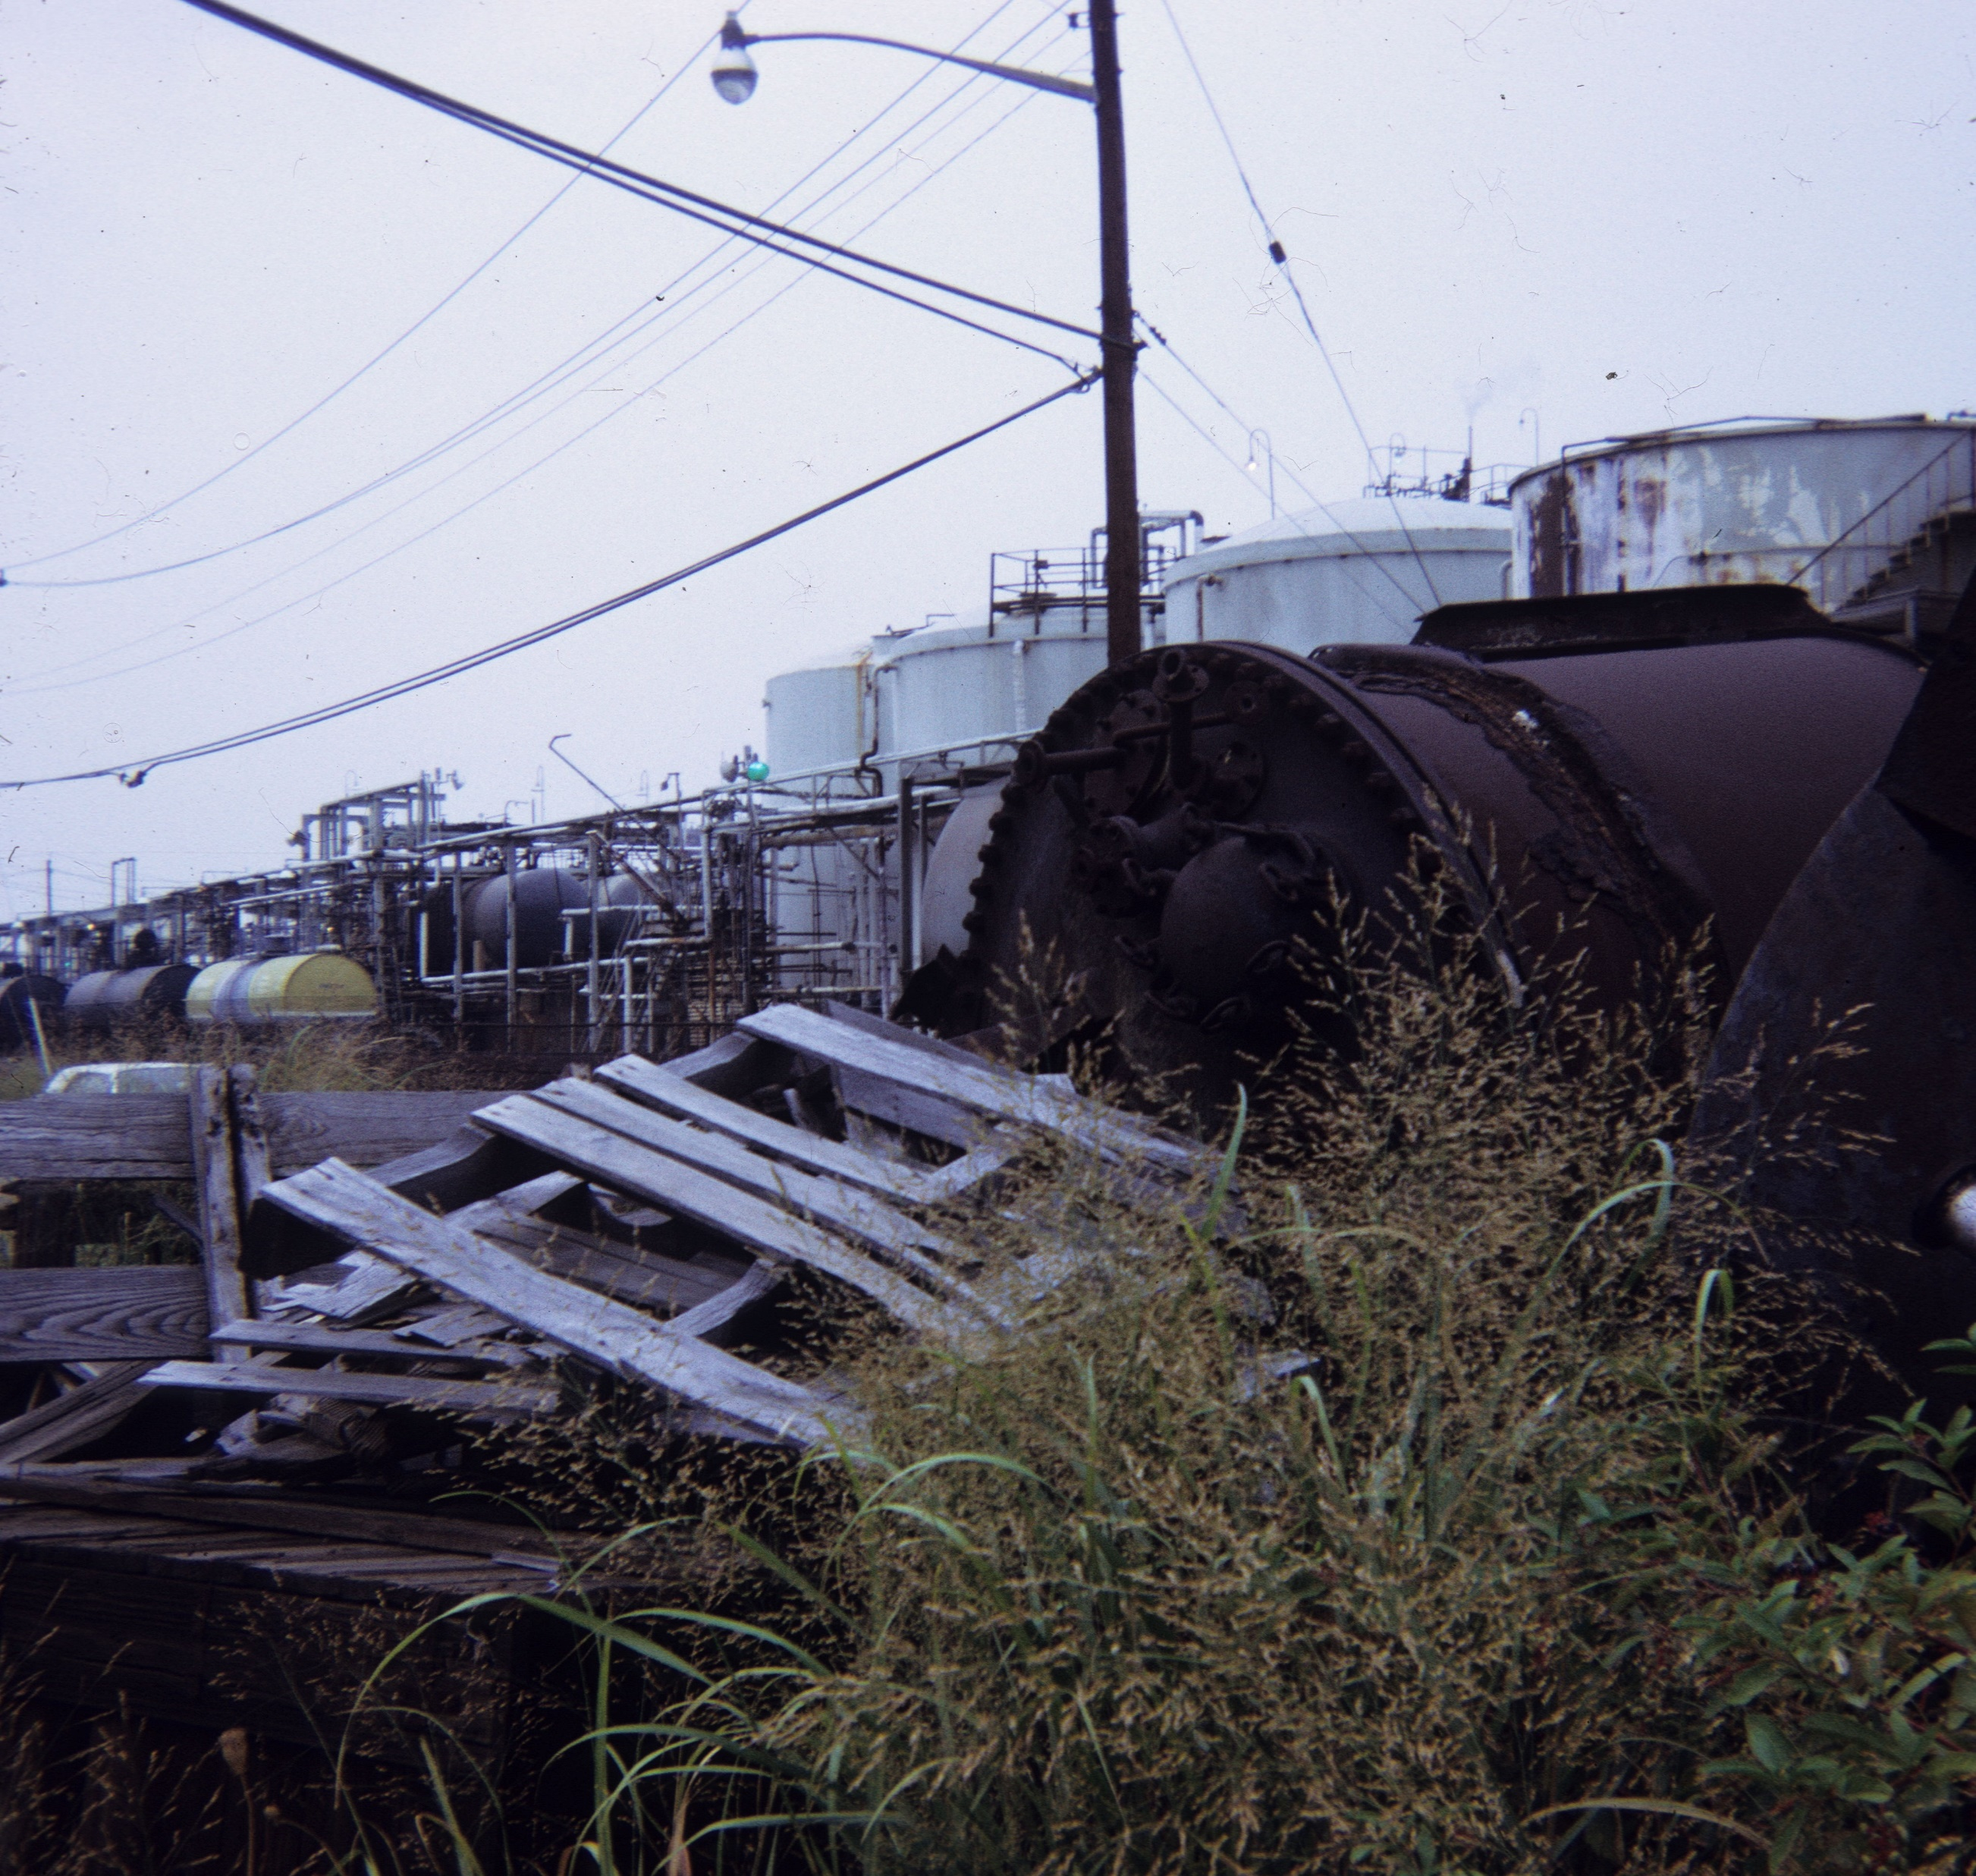
Removal of Toxic Waste
There are no easy solutions to eliminating toxic substances from the environment, and often the only solution is for time to pass to allow chemicals like DDT and PCBs to break down. Other techniques include:
Hazardous waste landfills- materials removed from contaminated sites may be stored in landfills. These have multiple plastic liners to prevent leaching into the surrounding environment. They also have a drain system for collecting liquid leachate for further treatment. The top of the landfill is capped with an impervious layer like concrete and then covered with soil.
Bioremediation- uses bacteria to decompose organic compounds into harmless substances.
Phytoremediation- uses plants to absorb toxic materials from the soil. Plants also may be used to immobilize toxins in the upper soil layers and out of ground water.

